Slide 1


Ireland’s Open Data Success Story, Challenges and Next Steps
7th October 2020

Slide 2


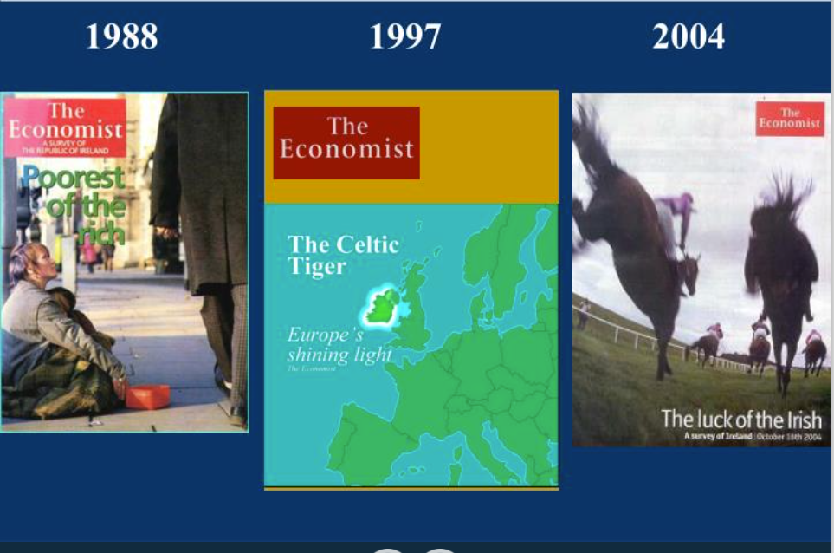
A few things about Ireland
Economic Success Story
Open Economy relying on Foreign Direct Investment
ICT
Innovation Ecosystem – Private/Public Partnership
eBusiness
Med Devices
Well educated workforce
FDI
Strong Emerging Tech Start-Up Innovation
Engineering
Pharma
Only English speaking country in the Euro zone (and soon EU)
Financial & International Services

Slide 3

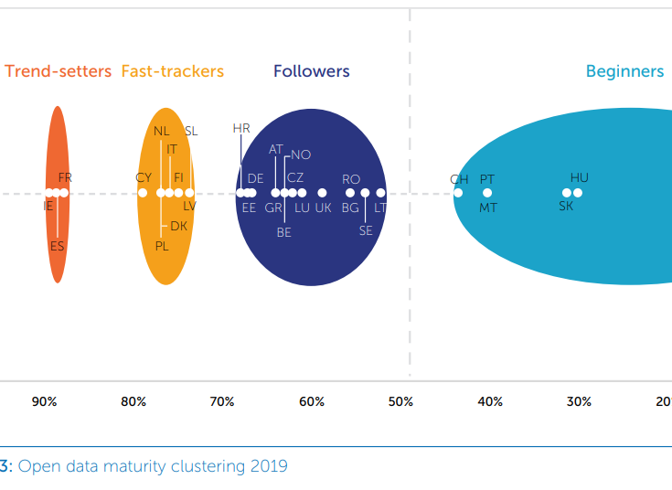
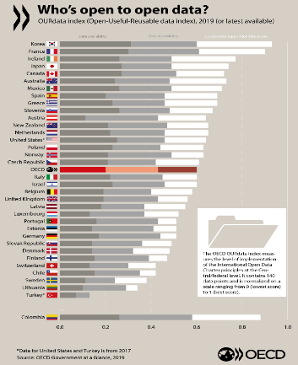
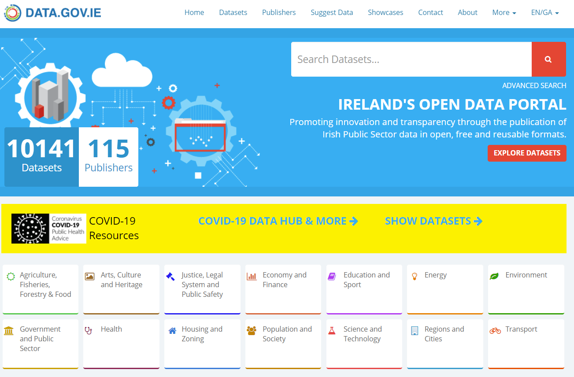
The Story behind the Success Story!
Leading European Commission study for three years in a row
3rd Globally in the OECD Open Gov Data Index
Establishing and Curating a community of 115 Publishers including Central Government, Local Authorities, Agencies
Building a Diverse array of Datasets
  Sectors
  Public Services
  Themes
  Formats

Slide 4
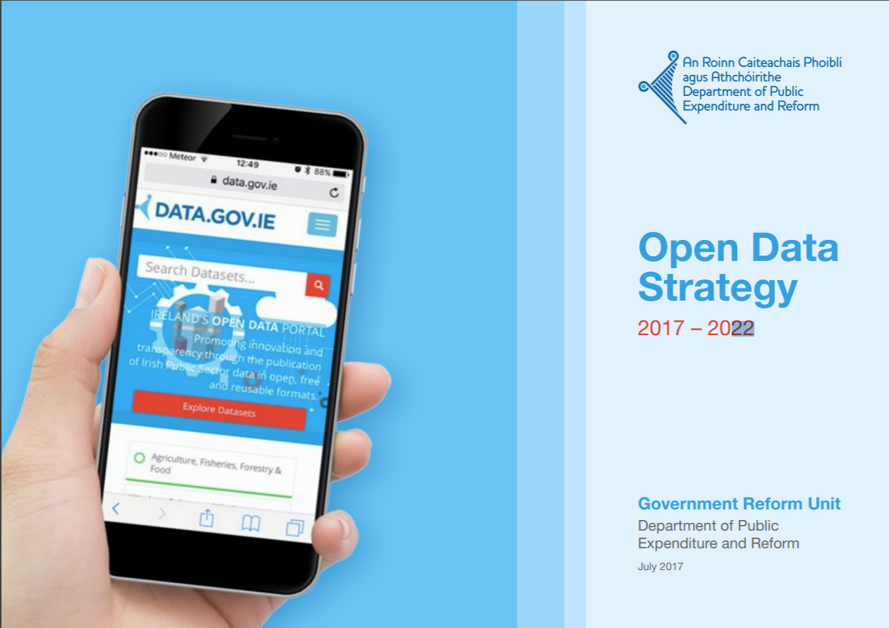


Looking Back - Key Success Factors
1
An ambitious vision with a clear implementation strategy,
driven by the Government Department in charge of Reform
2
Data Sharing and Governance Act
Legislative Support
Open Data Advisory Board
3
Effective governance and managed community beyond technical requirements
– Strong stakeholder engagement
Open Data Liaison Officers
Publication Workshops
4
Alignment with international best practice, standards and guidelines
Open Data Series
5
DX - a supportive private-sector partner, spanning policy to delivery of Data

Slide 5




Priorities going forward
Focus on Impact
High Value Datasets
Linkages
Access
Exploration and Visualisation
Harmonisation / Standardisation
Quality
Open Innovation and collaboration/exchange
Across Public Service Bodies
With Private Sector
Complete Data
Contribution
Consumption

Slide 6
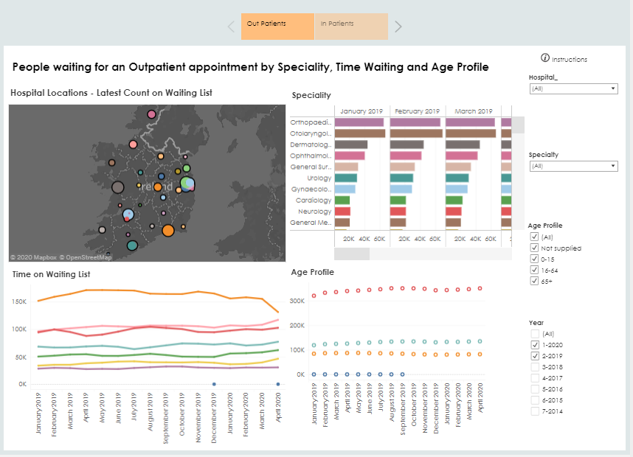
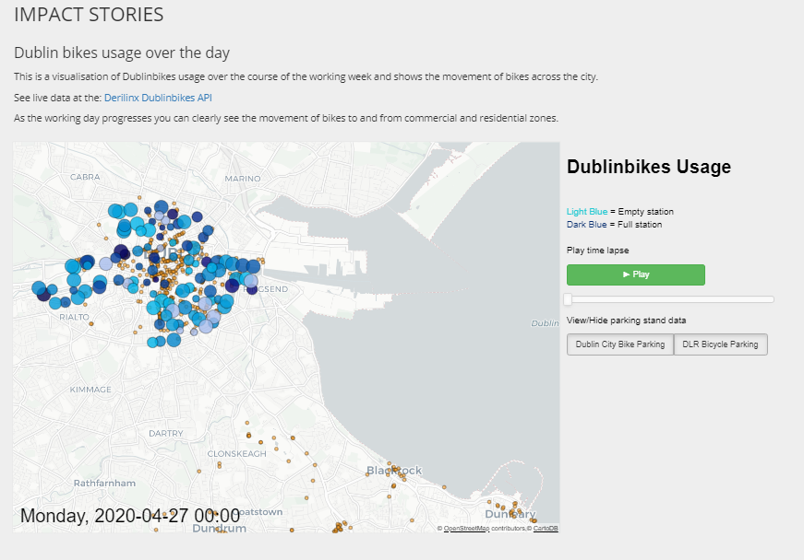

Slide 7
Sharing our experience – Data Catalogue
1
Management Support
Clear top-tier support of a data catalogue reflects the priority it is given within an organisation. Management can help communicate how the development of a data catalogue is a critical component of the organisation’s overarching knowledge management plan, and the impact it can have both internally and externally.
2
Organisation Buy-in
For a data catalogue to achieve its potential as an essential resource to an organisation, all employees must understand and feel its benefits. This includes employees from both technical and non-technical backgrounds. Ongoing training and communication can help employees become familiar with and see the value of a data catalogue.
3
User Buy-in
The end-users must see value in, and want to use, a data catalogue for it to be successful, whether the end-users are employees from within the organisation, employees from another PSB, or members of the general public.
4
Easy to Use
A data catalogue should be easy to use for a wide spectrum of non-technical users. Most users come to a data catalogue looking for particular information - this data should be easy to find through search, facets or other navigation features.
5
Up-to-Date Data
A data catalogue is only as good as its data is fresh. Users will continue to use the catalogue as long as the information available is kept up-to-date, otherwise users will quickly revert to looking elsewhere for their data sources.
6
Interoperable
The purpose of a data catalogue is to facilitate the discovery of and access to data. Therefore for a catalogue to be successful, it is critical that it is interoperable. This means that the data is accessible in a standardised manner, such as via an API, and according to accepted and accredited standards.
7
Security
It is imperative that a data catalogue is reliable and that robust security measures are put in place to ensure trust between all of the catalogue’s stakeholders. Personal data must be secured and protected from unauthorised internal or external access, and a clear approach should be defined for the secure handling of all data on the catalogue.

Slide 8
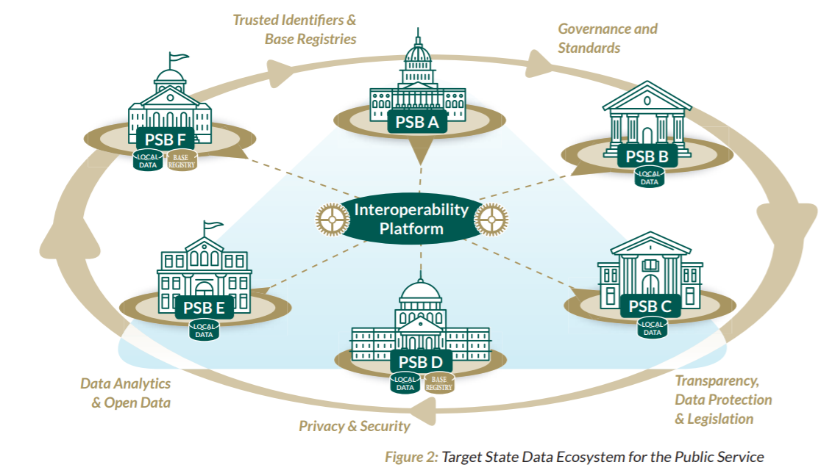
Public Service Data Catalogue
A step towards Interoperability
How can public sector underpin innovation and economic and social growth in the next phase?
The beginning of an interesting impactful journey!

Slide 9


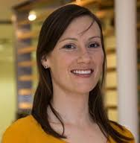
go raibh maith agat!
Takk skal du ha!
Pierre Baviera
CEO
pierre@derilinx.com
Fergal Marrinan
Director - Founder
fergal@derilinx.com
Deirdre Lee
Director - Founder
Deirdre@derilinx.com
www.derilinx.com

