Slide 1
AI/Data Driven Public Sector
Heather Broomfield UiO/Digdir

Slide 2
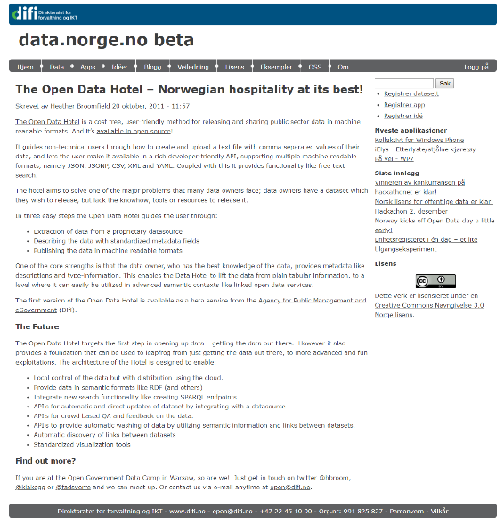
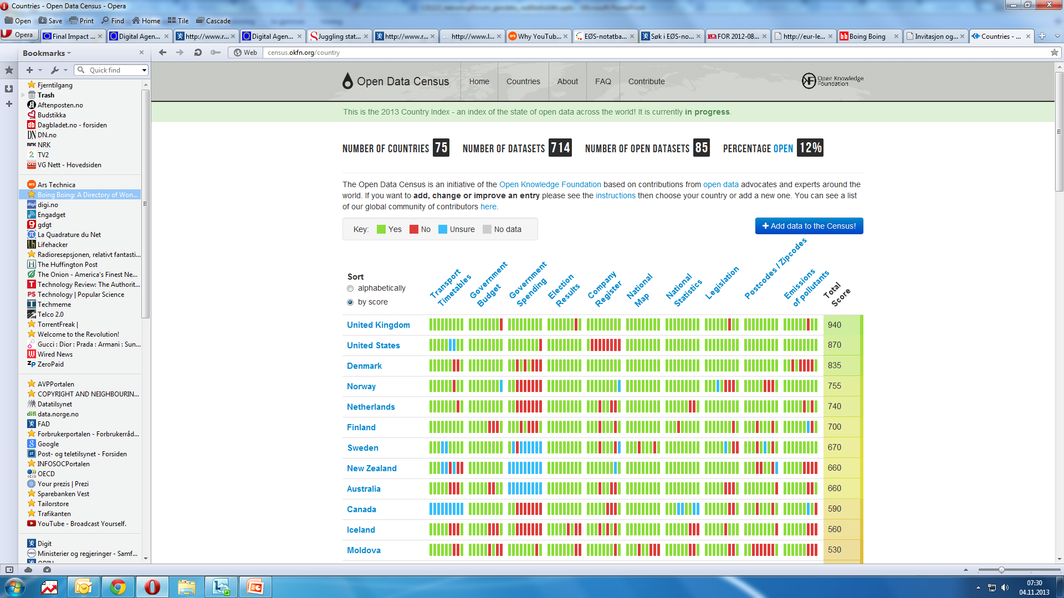
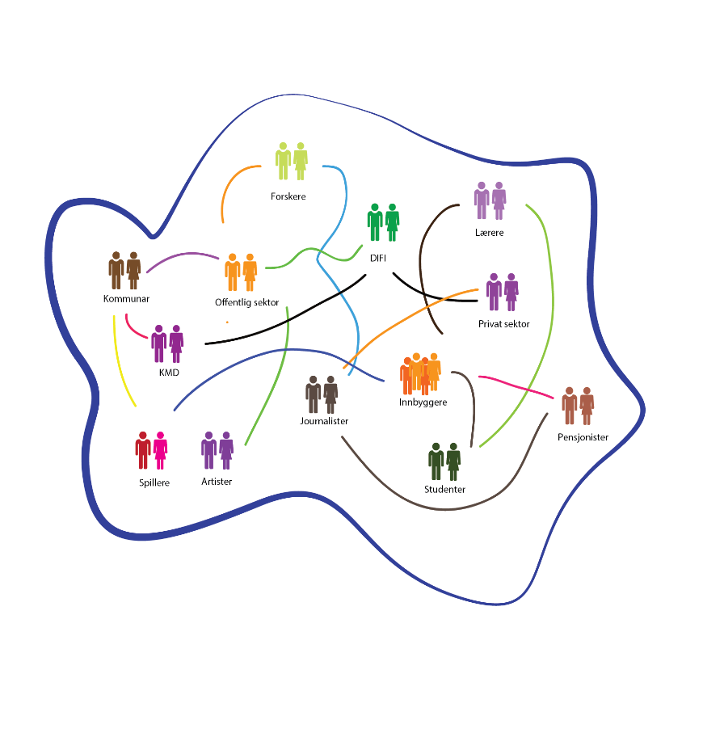
From Data Sharing to Data Driven
Offentlig PhD
‘We are in the midst of a data-driven social and political transformation, a shift so significant some are calling it a paradigm shift’ Joanna Redden 2018
The Data Driven Public Administration: A critical assessment of its framing and implementation
Submitted June 2024
6 papers + Kappe
Google Scholar: Heather Broomfield
Økosystemet for opne data i Norge
Data-driven public administration is ushering in a new and all encompassing chapter in the extensive history of public administration reform
Bullock 2019
2011
2019
2024

Slide 3
The challenge for public leadership in the age of the algorithm is as much about the framing of problems as their resolution.
Andrews 2019
Notes:
Are we grasping the hard choices that have to be made?

Slide 4
Data Driven public sector
=
More, different and new data
(created and driven by digitalisation)
Advanced methods for use, analysis and recirculation of data (machine learning, Artificial intelligence)

Slide 5
The reality of what is possible
Public Services can be redesigned and reengineered from the ground up!
Mergel et al., 2018
Do we have a shared understanding of what is possible and what we want to achieve?
The spectrum is a tool to communicate what is possible

Slide 6
Possibilities for data driven
Reduced bhg rates based on income level
Support based on economic context
Personalised medicine
Predict cancers based
on lifestyle habits
Workforce Planning
Image AI screening for breast cancer
Hearings
Insights through data
Data Driven Policy making
Data driven is achievable in Norway on a scale that other countries can’t aspire to!
Broomfield, Heather, Toward a Common Understanding of a Data-Driven Public Sector - A Conceptual Framework (December 4, 2022). Available at SSRN
Notes:
Høyring nyttar ein for at innbyggjarar, organisasjonar og næringsliv skal få seie si meining og kunne føre kontroll med kva forvaltninga gjer og korleis ho utfører oppgåvene sine.
Hearings are vested interests

Slide 7
Data Driven Public Services Spectrum
Reduced bhg rates based on income level
Support based on economic context
Vast majority of public sector
Vast majority of research, civil society & private sector
Digitised services
Transformed services
Rules
Probability
Reactive
Proactive
Real Time
Prediction
User
Citizen
Complexity, Paradigm shift, Scope creep, Unintended consequences,
Conscious public leadership choices
Broomfield, Heather, Toward a Common Understanding of a Data-Driven Public Sector - A Conceptual Framework (December 4, 2022). Available at SSRN

Slide 8
Data Driven Public Services Spectrum
Reduced bhg rates based on income level
Support based on economic context
Vast majority of public sector
Vast majority of research, civil society & private sector
Digitised services
Transformed services
Data profile:
Predominantly personal data
Event/register-data
Primarily structured data
Small/deep data
Strong regulatory protection
Primary focus on individual
Rules
Probability
Data Profile:
Personal and non-personal data
Mostly behavioural data
Structured and unstructured data
Big data
Weaker regulatory protection
Focus on herd and individual
Reactive
Proactive
Real Time
Prediction
User
Citizen
Complexity, Paradigm shift, Scope creep, Unintended consequences,
Conscious public leadership choices

Slide 9
Data Driven Public Services Spectrum
Reduced bhg rates based on income level
Support based on economic context
Vast majority of public sector
Vast majority of research, civil society & private sector
Digitised services
Data
Transformed services
Data profile:
Predominantly personal data
Event/register-data
Primarily structured data
Small/deep data
Strong regulatory protection
Primary focus on individual
Rules
Probability
Data Profile:
Personal and non-personal data
Mostly behavioural data
Structured and unstructured data
Big data
Weaker regulatory protection
Focus on herd and individual
Regulation
Reactive
Proactive
Finance
Real Time
Governance
Prediction
User
Competence
Citizen
Complexity, Paradigm shift, Scope creep, Unintended consequences,
Conscious public leadership choices

Slide 10
«User centric»
«Seamless services»
Do we have a shared understanding of what is possible and what we want to achieve?
«AI in the Public Sector»
«Share and use data»
«Digitalisation friendly regulation»
«Digital transformation»
«needs based»

Slide 11
“Magic” is entertaining. It excites discussion, but when the show is over many hard choices remain. Turning symbols into practice is not an easy task.
«User centric»
«Seamless services»
Do we have a shared understanding of what is possible and what we want to achieve?
«AI in the Public Sector»
«Share and use data»
Christensen & Lægreid, 2003
«Digitalisation friendly regulation»
«Digital transformation»
«needs based»

