Slide 1

Trustworthy AI lab ved Høgskolen i Østfold og bruk av Z-Inspection®
En prosess for å evaluere etiske aspekter og troverdighet ved utvikling av KI-løsninger
Digitaliseringsdirektoratet 21. sep 2023
Pedro Kringen, dr.
Trustworthy ai lab
Dept. of Engineering
Østfold University College (HiØ)
Norway
https://www.hiof.no/iio/ing/english/research/groups/innovation
Z-Inspection Initiative, Big Data Lab
Goethe Universität, Frankfurt
Germany
http://z-inspection.org
http://www.bigdata.uni-frankfurt.de/pedro-kringen/

Slide 2
What is Z-Inspection®?
Building artificial intelligence (AI) systems that adhere to ethical standards is a complex problem. Although there are numerous guidelines for the design and development of such reliable AI systems, these guidelines focus on high-level and abstract requirements for AI systems. It is often very difficult to assess whether a specific system meets these requirements.
This is for now a non-profit organization – purely academic!
So, we created an orchestration process to help teams of skilled experts assess the ethical, technical, domain-specific, and legal implications of the use of an
AI-product/services within a given context.

Slide 3



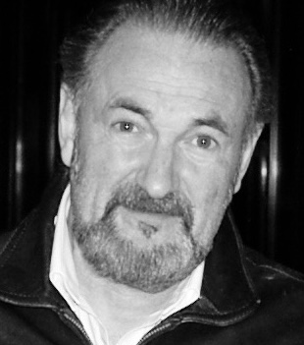
Who are we? The Norwegian AI Lab
Professor dr. Roberto Zicari from Goethe University in Frankfurt. Z-inspection Initiative
Associate Professor, dr. Frode Ramstad Johansen, HiØ
Associate Professor, dr. Gunnar Andersson , HiØ
Z-inspection Initiative, dr. Pedro Kringen, HiØ
Roberto Zicari
Frode Ramstad Johansen
Roberto Zicari
Pedro Kringen
Gunnar Andersson
Pedro Kringen
Gunnar Andersson

Slide 4

Where are we? A global community working together
Tampere
Fredrikstad
Helsinki
Europe
CPH
Den Haag
Hannofer
Poznan
Berlin
Luxembourg
Strasbourg
Montreal
Frankfurt
Montreal
Venice
Ottawa
Chicago
Ottawa
Bologna
Chicago
Pisa
Greece
North
America
Soul
Kyoto
Asia
Ibadan
Sharawak
South
America
Africa
MElbourne
Australia

Slide 5

Why Trustworthy AI?
“Everything we love about civilization is a product of intelligence, so amplifying our human intelligence with artificial intelligence has the potential of helping civilization flourish like never before
– as long as we manage to keep the technology beneficial.“
- Max Tegmark, President of the Future of Life Institute, Royal Institute of Technology UC Berkeley

Slide 6
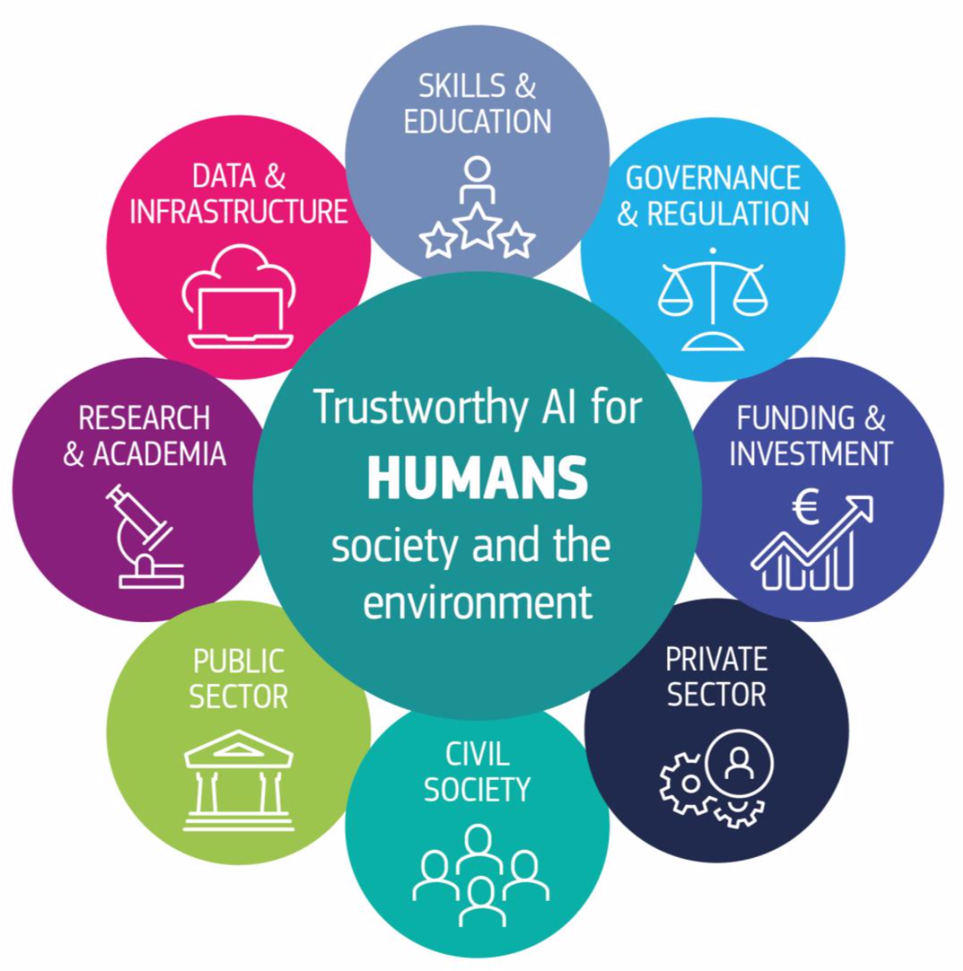
Why Trustworthy AI?
Ethical and societal implications of AI require rigorous scrutiny
The ethical and societal implications of AI within many domains are significant and require thorough investigation.
Issues such as algorithmic bias, data privacy, and the potential for job displacement due to automation have already begun to emerge as challenges.

Slide 7
What is a Trustworthy AI Lab?
An interdisciplinary and international forum for the evaluation and discussion of the responsible use of Artificial Intelligence

Slide 8
What is a Trustworthy AI Lab?
The Labs encourages debate and reflection on the responsible use of Artificial Intelligence

Slide 9
What is a Trustworthy AI Lab?
Creates events and offer possibility of teaching and doing research

Slide 10
AI - good or bad?
ChatGPT code: Hacker Exploits
ChatGPT: Illicit Manuals for Bombs and Weapons
Insurance companies: Data Vulnerability
Innovation: Technological Advancement
Diagnostics: Medical Precision
Speed: Increased Working Capacity
Education: Knowledge Dissemination

Slide 11
We use the EU Framework for reviewing Artificial Intelligence
Eu-framework
The EU High-Level Expert Group on AI defined ethics guidelines for trustworthy artificial intelligence:
(1) lawful - respecting all applicable laws and regulations
(2) ethical - respecting ethical principles and values
(3) robust - both from a technical perspective while taking into account its social environment
Source: Ethics Guidelines for Trustworthy AI. Independent High-Level Expert Group on Artificial Intelligence. European Commission, 8th April 2019.

Slide 12
Z-Inspection®
EU High-Level Expert Group on AI has presented a framework for ethical AI.
Z-Inspection may be an official tool for approval of the tested AIs in the future.
AIs are tested and our feedback improve their AI by identifying ethical dilemmas
Different domains are inspected; medicine, governmental tax office, land measurement, philosophy, and political science

Slide 13
Z-Inspection® uses Four Ethical Principles
Four ethical principles, rooted in fundamental rights
(i) Respect for human autonomy
(ii) Prevention of harm
(iii) Fairness
(iv) Explicability
There may be tensions between these principles.
Source: Ethics Guidelines for Trustworthy AI. Independent High-Level Expert Group (HLEG) on Artificial Intelligence. European commission, 8th April 2019.

Slide 14
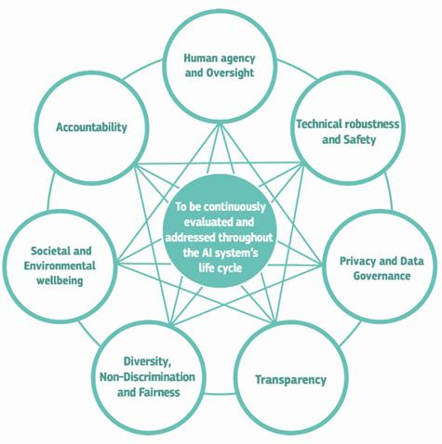
We use seven requirements for Trustworthy AI
Source: Ethics Guidelines for Trustworthy AI. Independent High-Level Expert Group on Artificial Intelligence. European commission, 8th April 2019.

Slide 15
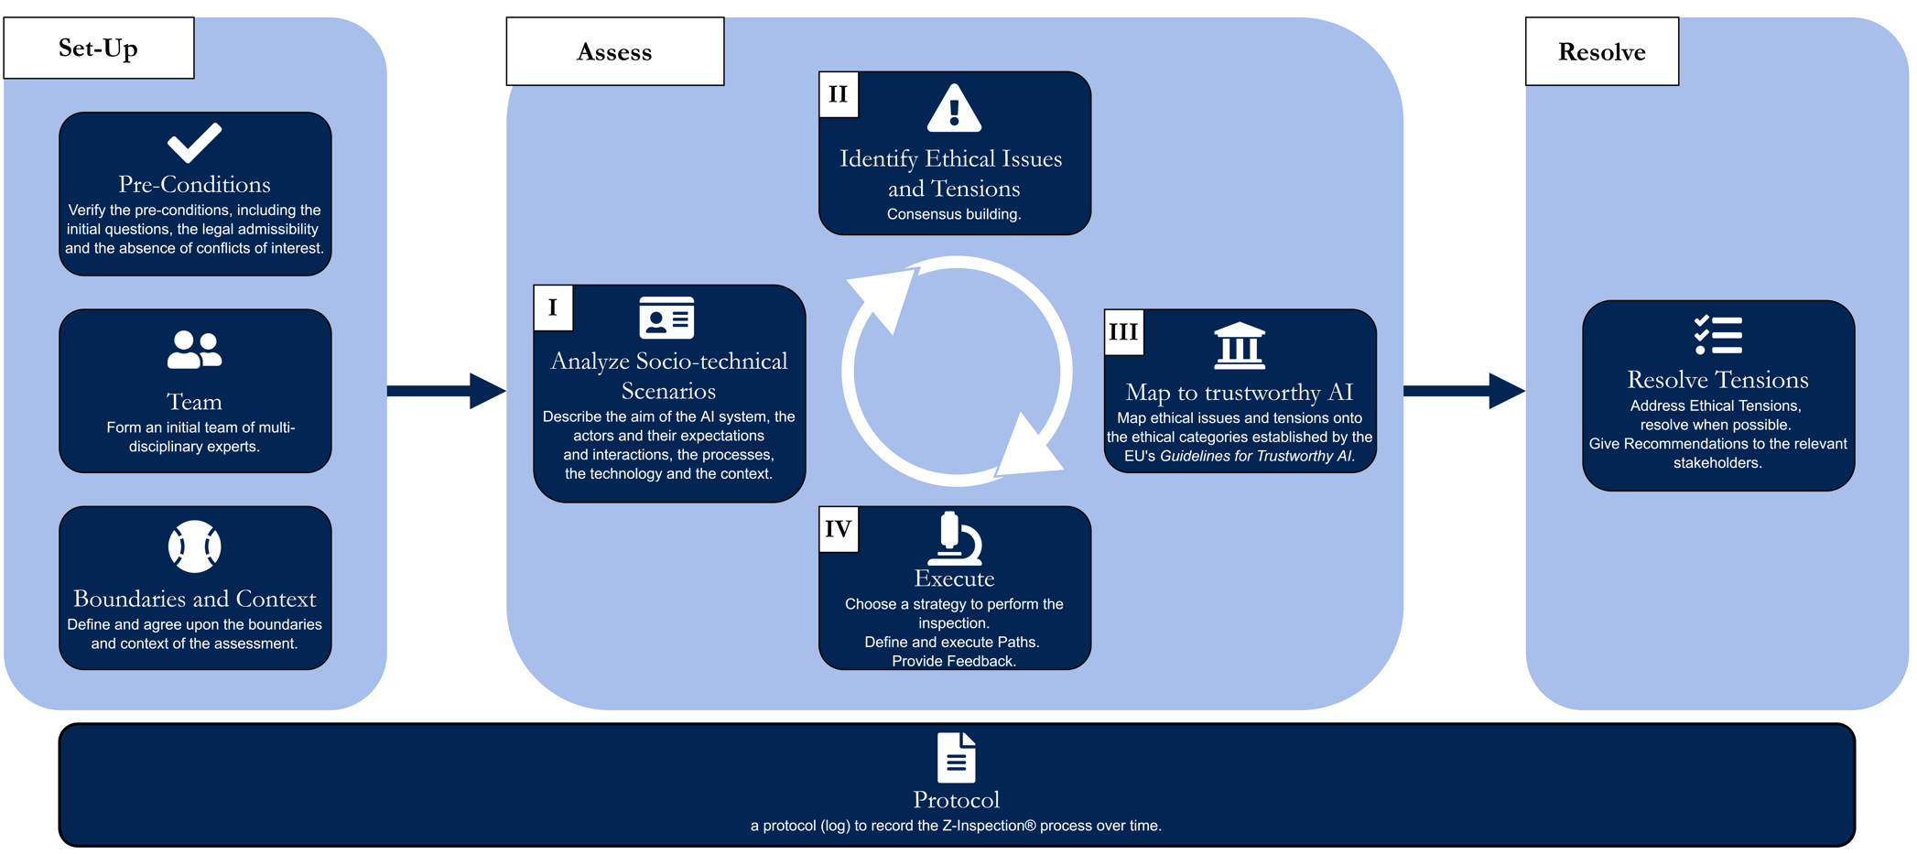
Z-inspection® Process in a Nutshell

Slide 16

Z-inspection® can be applied to the Entire AI Life Cycle
Design
Development
Deployment
Monitoring
Iterative improvement

Slide 17
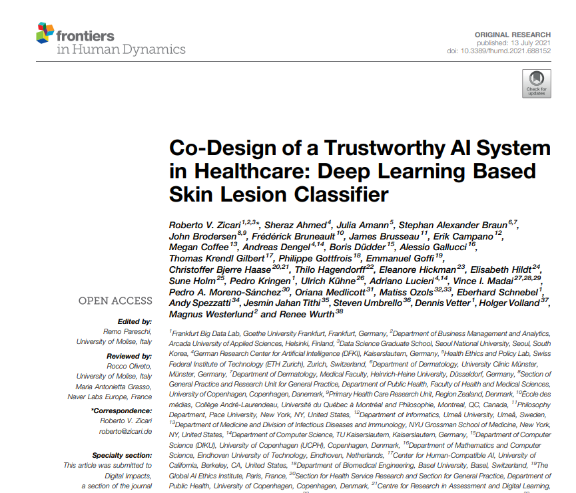
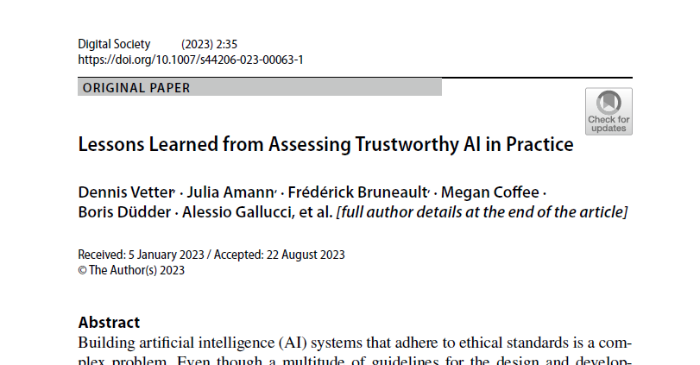
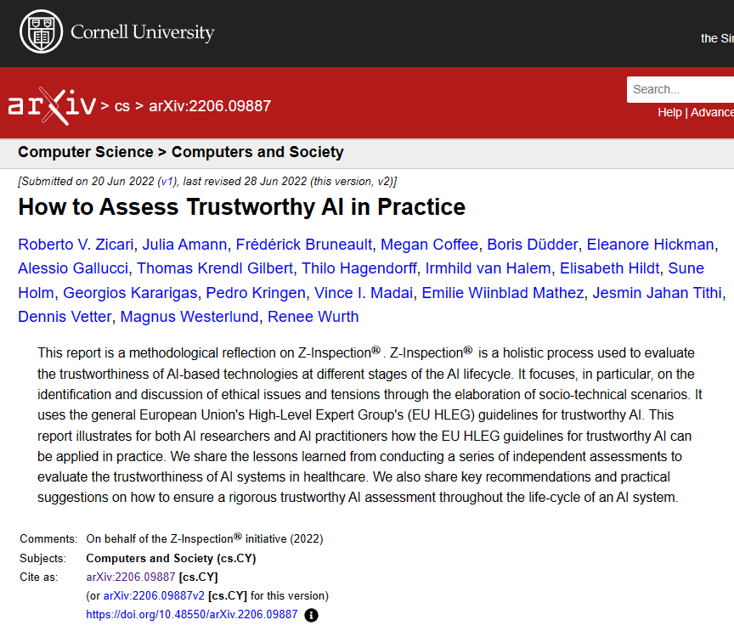
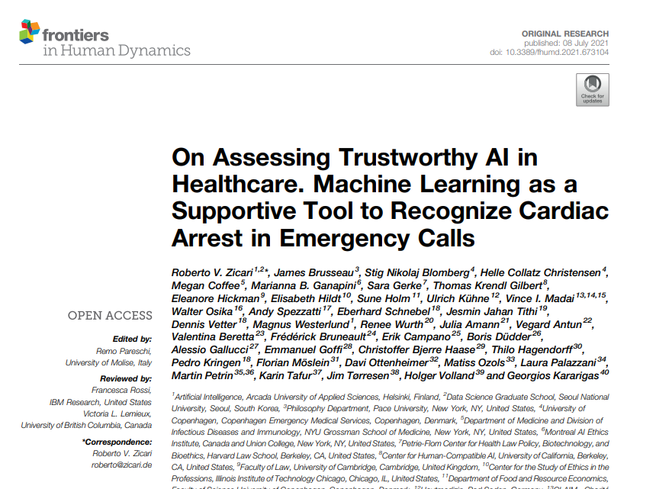
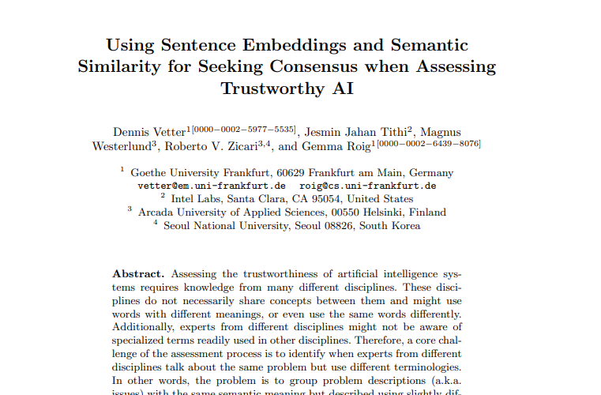
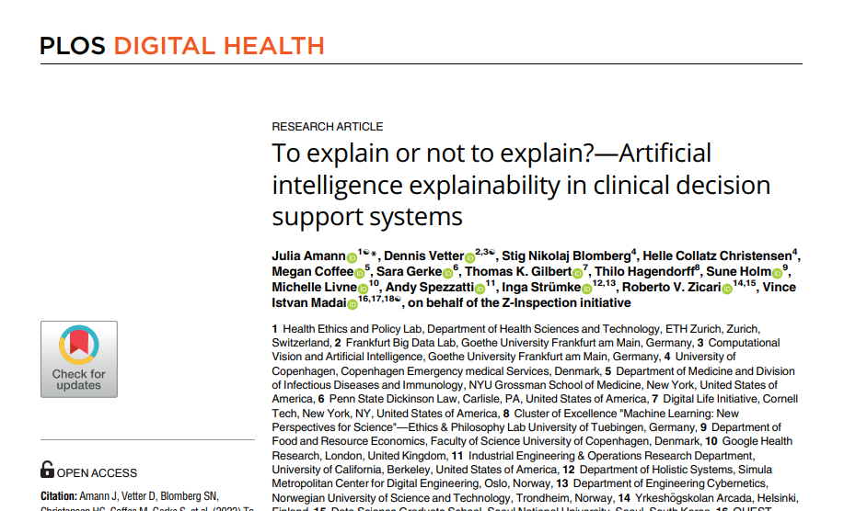


Some publications

Slide 18
Take home messages
Ethics is a challenge in relation to use of AI
New, fast-evolving technology and regulations are not in place
Z-Inspection® is one of the first tools to assess ethical aspects in AI and is the most comprehensive method as of today
Several use cases within different fields have had their AI assessed and the results published

