Slide 1


Open Science i transportforskningen – Framtidige virkninger
Faglig arena for datadeling og Informasjonsforvaltning
Anja Fleten Nielsen
Transportøkonomisk Institutt
This project has received funding from
the European Union’s Horizon 2020 Research and Innovation Programme
under Grant Agreement No 824323 and Grant Agreement No 824350

Slide 2
Impact assessment of Open Science in transport
Environmental
Social
Economic

Slide 3
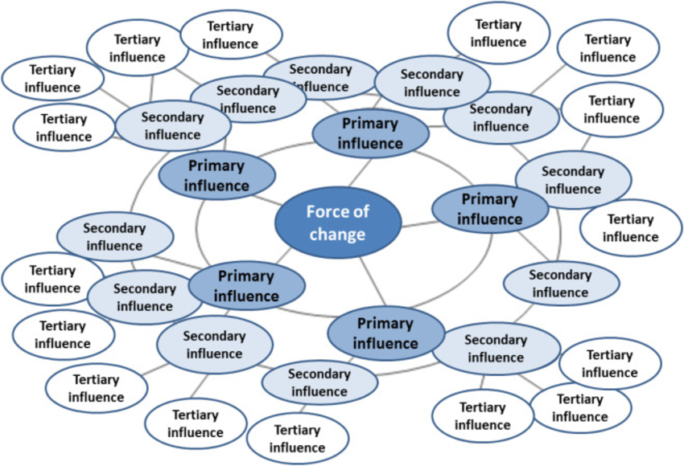
Future wheel

Slide 4
Open Science
Open Access
Open Source Software
Open Data
Citizen Science

Slide 5
Smarter solutions for better analysing
Time saving for user -> more economic
Economy
More flexible and quick in terms of innovation
Harmfull effects for individuals if GDPR data is hacked
Reduced participation from public in surveys
Society
Trend: Increased use of open sourse software
Lower security level when handling data
Financial loss for companies
Malicious users creating bugs i.e. to infect hardware
Economy
Higher availability
Incresed possibilites for researchers with low financial support
Generate more research
Multilevel

Slide 6
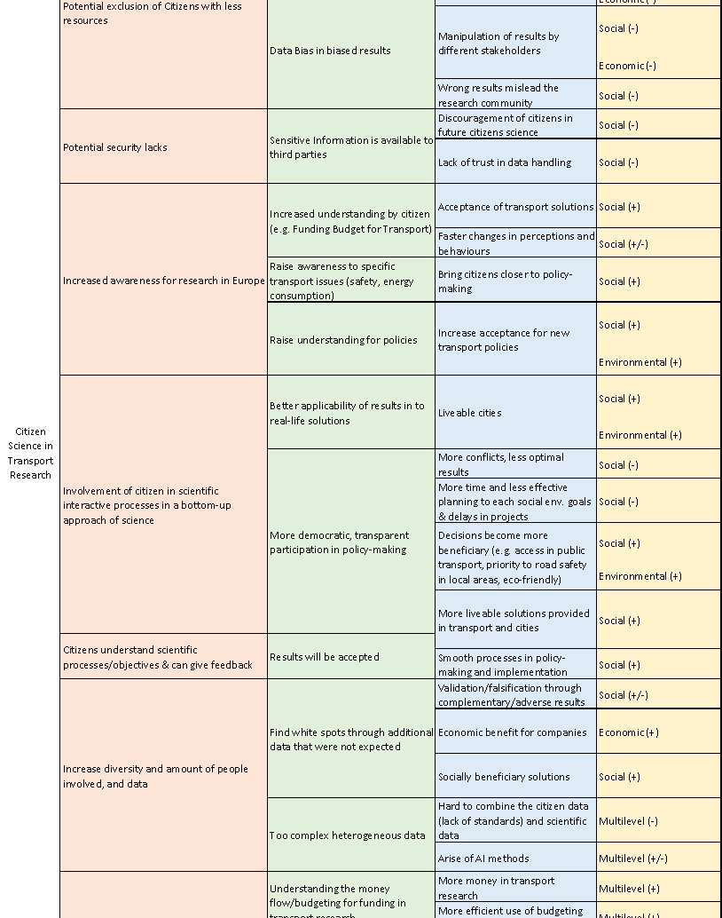
DATA

Slide 7
General Impacts
/
Equality
Efficiency
Economic benefits
Innovation and new technology
Citizen participation

Slide 8
Transport specific impacts
Lower emission
Faster travel time
Improved traffic safety
Increased awareness
Artificial intelligence

Slide 9
Negative impacts
Job loss
New types of risks
Increased cost
Conflicts
Time delays
Increased energy consumption

Slide 10
VIDERE LESNING
Rapporten:
https://beopen-project.eu/storage/files/beopen-d53-impact-assessment-of-open-science-in-transport.pdf
TOPOS:
https://www.topos-observatory.eu/

